Slide 1
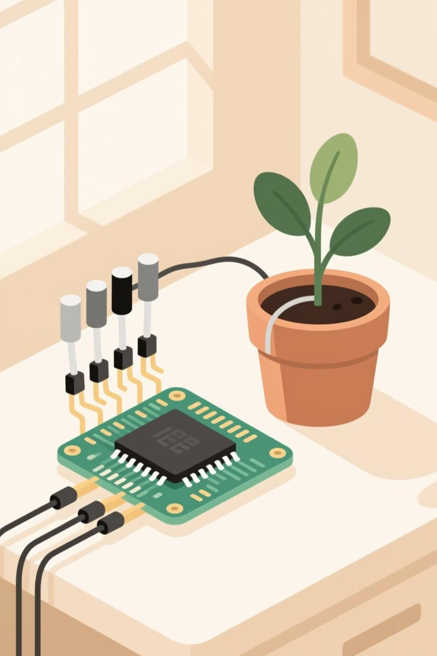
Team 16
The HackPHS Plant Monitor
Devansh Malhotra, Ayan Bindal

Slide 2

Chapter 1
A Necessary Pivot
Initial Goal: Weather Station
The Hardware Challenge
The New Focus: Plant Care
Unfortunately, multiple hardware components failed during the event, forcing a rapid strategic pivot and reevaluation of our available resources.
We quickly adapted to create a compact plant monitoring system, leveraging the other Raspberry Pi, microcontroller and LEDs to measure environmental conditions without traditional sensors.
We initially envisioned a wireless weather station, combining nature observation with data communication, utilizing hardware we had on hand.

Slide 3
Core Functionality: What the Monitor Does
Moisture Monitoring
Light Spectrogram Analysis
Integrated User Support
The system measures the voltage drop between two electrodes inserted into the soil. This provides real-time data to the user, indicating when watering is required.
An RGB spectrogram tracks the amount and colour of light exposure, crucial factors that significantly impact a plant's overall health and photosynthesis processes.
By combining moisture and light data with visual graphs and AI-driven tips, this tool offers quick and specific guidance tailored to YOUR unique plant.

Slide 4
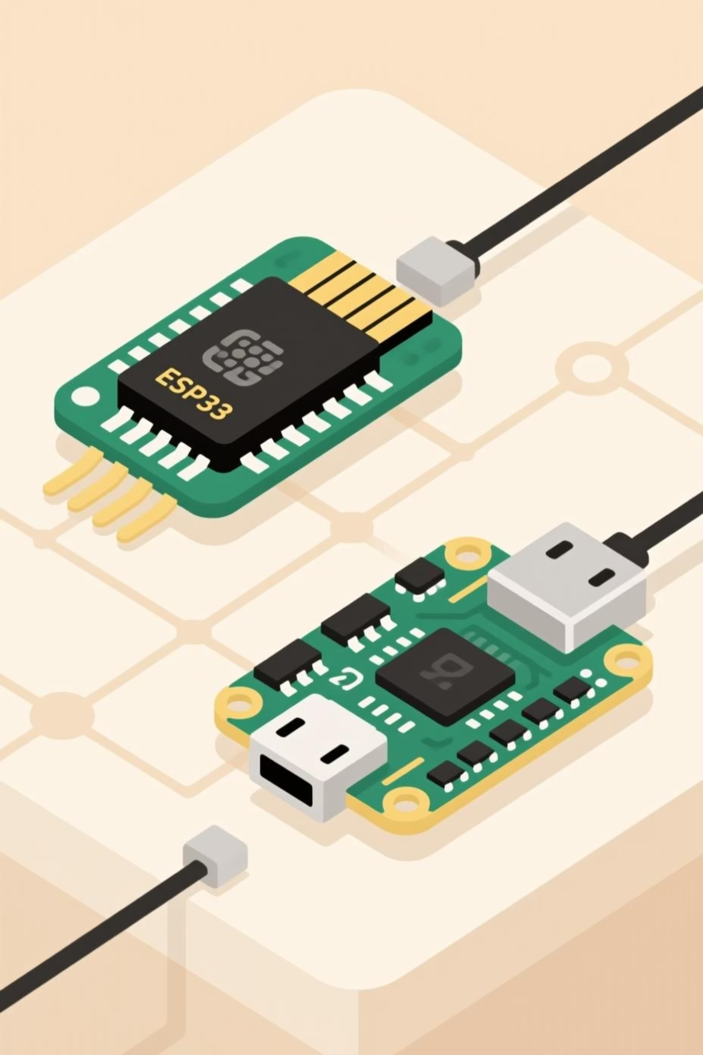
The Architecture: How We Built the System
The Node and Data Transmission
The Server Unit
A Raspberry Pi Zero 2W acts as the server, complete with a hard drive for storage and a TFT display for visualization.
We used a Wemos C3 Mini (ESP32) as the main "node" for gathering environmental data.
The node is powered by a USB battery bank and enclosed in a custom 3D-printed case, ensuring portability and protection.
Three physical buttons allow users to quickly interact with the data or export CSV files for external analysis (e.g., in Excel).
Data is transmitted wirelessly from the node to the central server unit.

Slide 5
Technical Deep Dive
Custom Hardware Integration
Power and Enclosure
Encased the Wemos C3 Mini in a precise 3D-printed housing, ensuring durability and clean aesthetics for the portable data node.
USB-A Port Modification
Successfully harvested and soldered a USB-A female connector to the Raspberry Pi Zero 2W, necessary for connecting the external hard drive.
Integrated System Finalisation
The result is a tightly integrated system, seamlessly combining microcontroller data collection with a dedicated server and visualization interface.

Slide 6


Major Challenges Encountered
Rapid prototyping always presents hurdles. Here are the most significant obstacles we overcame during development:
The Micro-Soldering Task
Iterative 3D Design
Software vs. Hardware Debugging
Designing the custom server case required multiple rapid iterations, including test fitting, redesigns, and reprinting within a severely compressed timeline.
Harvesting the USB-A female socket proved incredibly difficult, requiring precise soldering onto very small pads on the Raspberry Pi Zero 2W board.
The most time-consuming challenge was debugging the code, as the underlying issues were often ambiguous—was it a software bug or a hardware failure? This complexity ultimately limited our goals for the weekend.

Slide 7
Chapter 2
Proud Accomplishments
Despite the setbacks, we achieved several critical milestones that showcase the team’s technical capabilities and ingenuity.
Light Data Collection
Moisture Data Acquisition
Successfully implemented the ability to gather individual light spectrum data.
Validated the method for gathering accurate soil moisture readings via voltage drop.
Server Case Design
USB-A Port Connectivity
Completed the functional and aesthetic design and 3D printing of the server unit enclosure.
Successfully integrated the harvested USB-A port onto the Raspberry Pi Zero 2W.

Slide 8
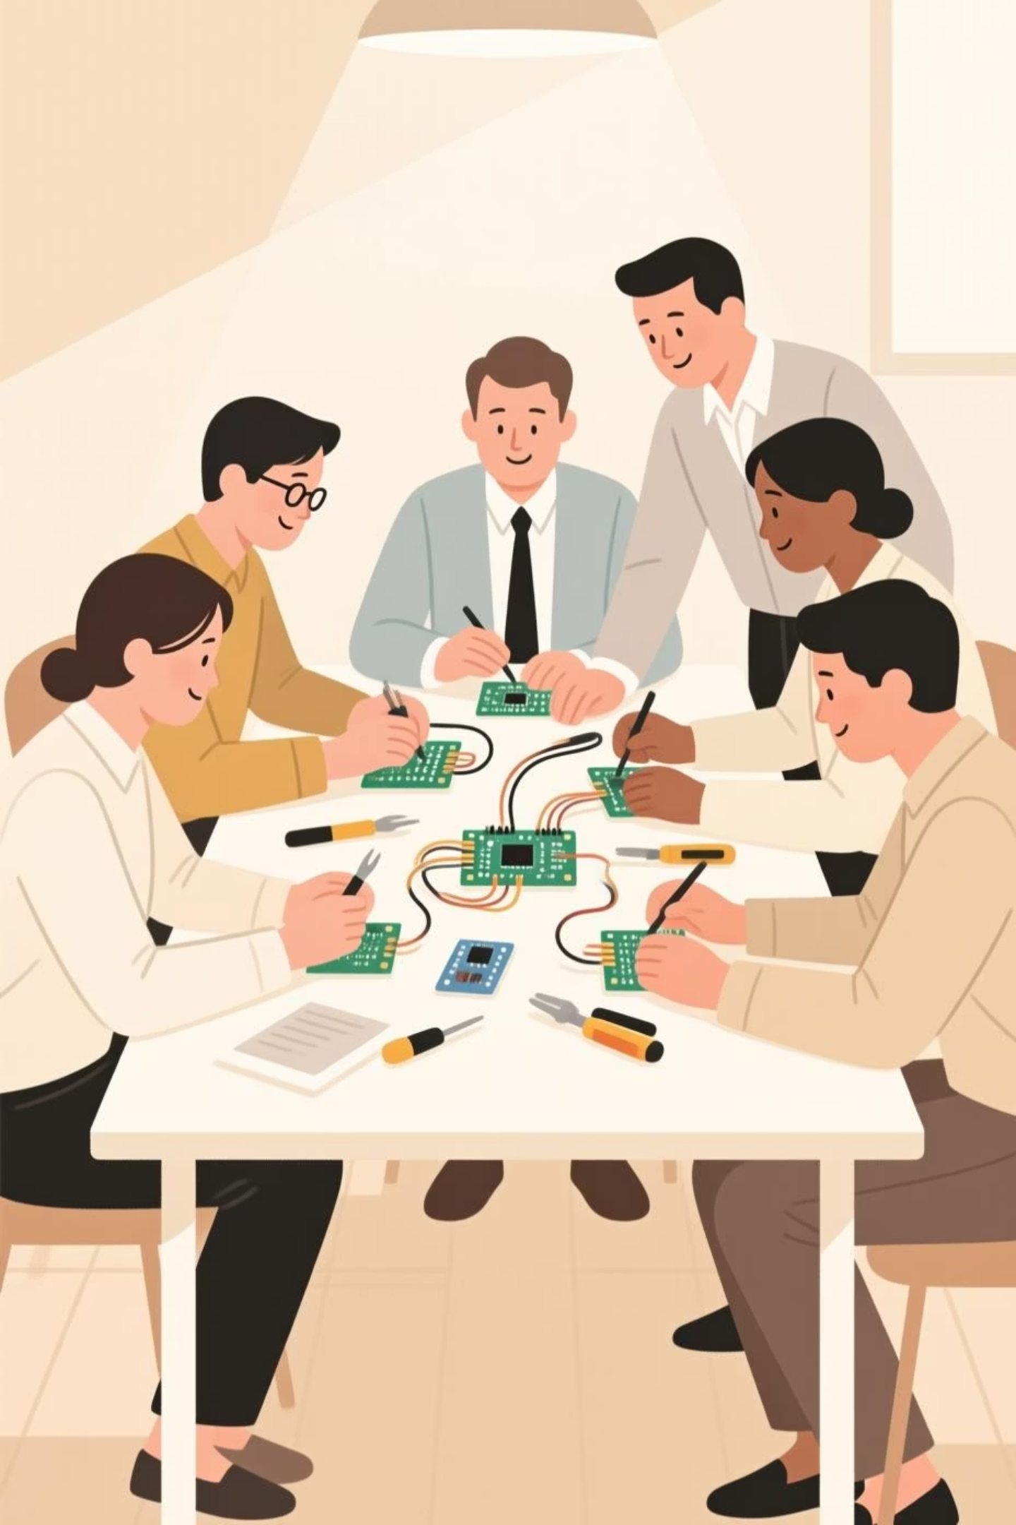
Key Learnings for Future Hacks
Every challenge is an opportunity for learning. These three takeaways will guide our future rapid prototyping efforts.
1
Hardware Pre-Check
Always conduct a thorough check of all hardware components to confirm functionality before the event begins to avoid unexpected failures.
2
Library Research
Research necessary libraries ahead of time. This provides a clearer understanding of their optimal use cases and potential limitations, streamlining software development.
3
Define Team Roles
If a team is planned, define clear roles and responsibilities beforehand. This allows members to focus on their strengths and preferred tasks for maximum efficiency.

Slide 9
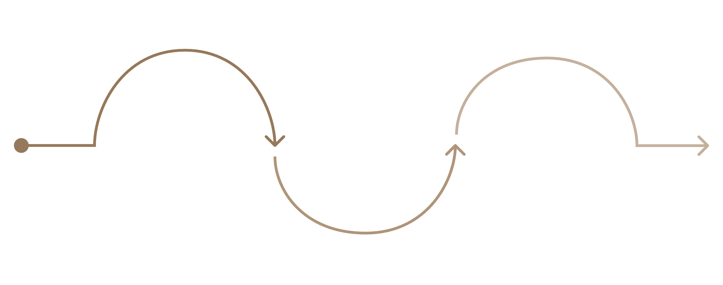
Future Roadmap: What's Next
The HackPHS Plant Monitor is a proof of concept. Our next steps focus on refinement and transforming the prototype into a polished, usable desktop gadget.
Node Refinement
Desktop Gadget
Server Enhancement
Proper packaging and sensor calibration
Finalize form and polish for release
Display integration and button functionality

Slide 10
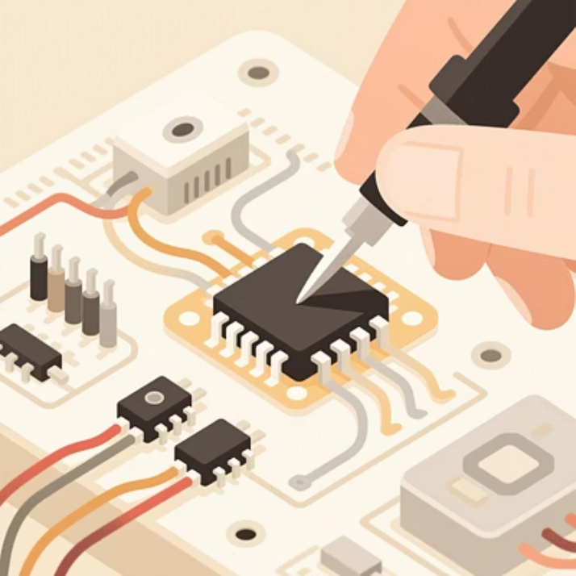
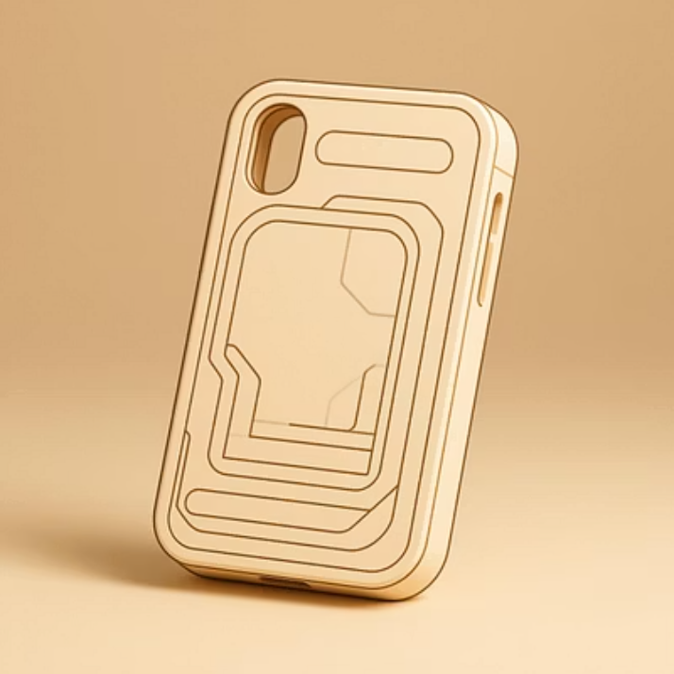
Conclusion
From Prototype to Product
The journey of the HackPHS Plant Monitor demonstrated our ability to pivot under pressure, solve complex hardware integration issues (like the USB-A mod), and build a functional, integrated data system from limited resources.
We are excited to finalize the project, fully package the node, and integrate the display and buttons to create a true, user-friendly desktop plant monitoring gadget for all makers.

